Slide 1
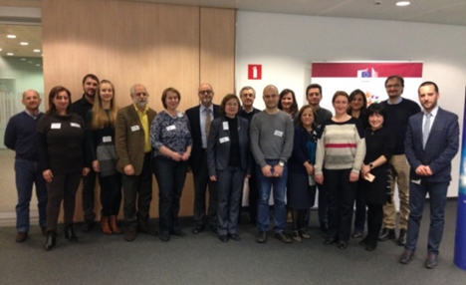
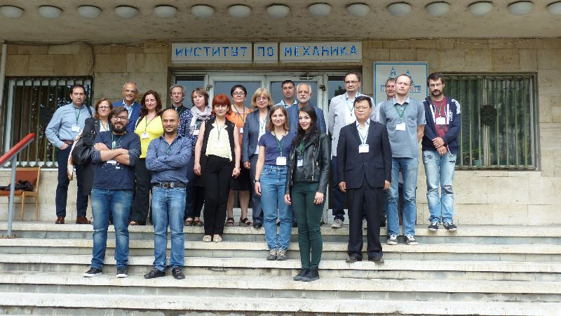
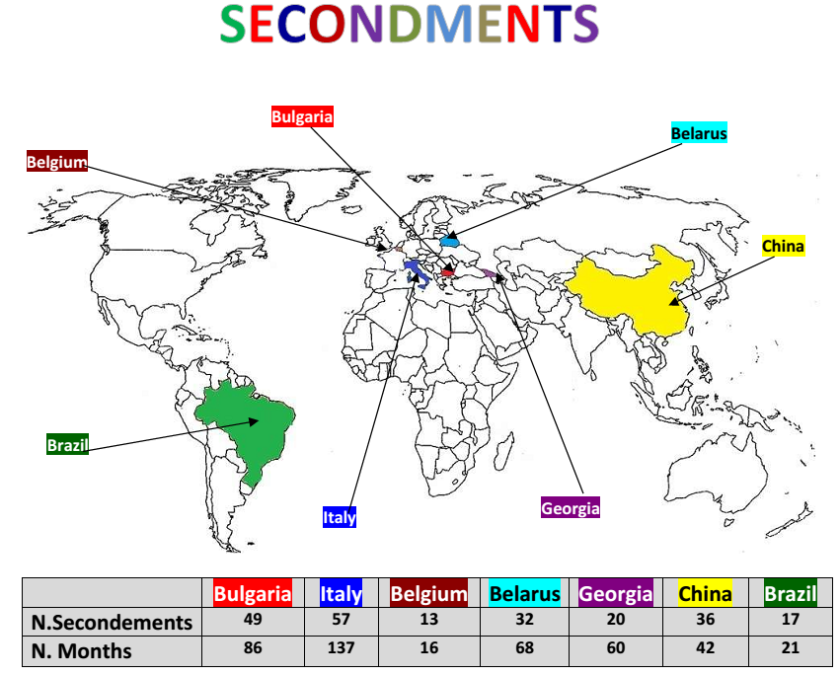
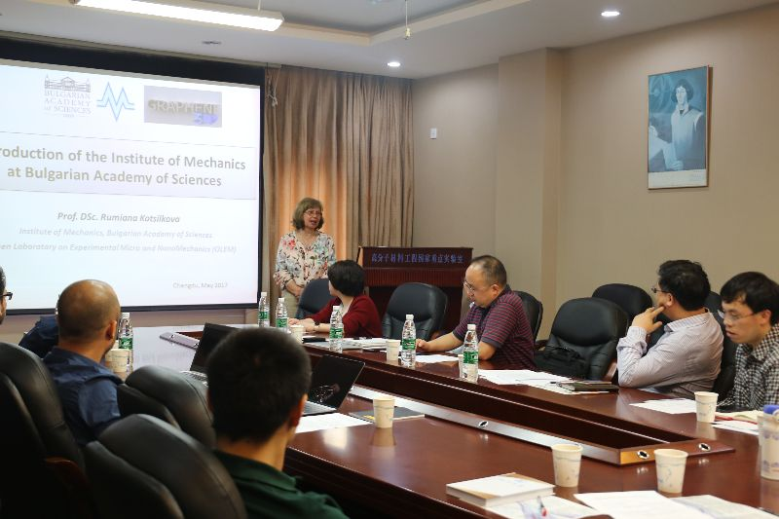
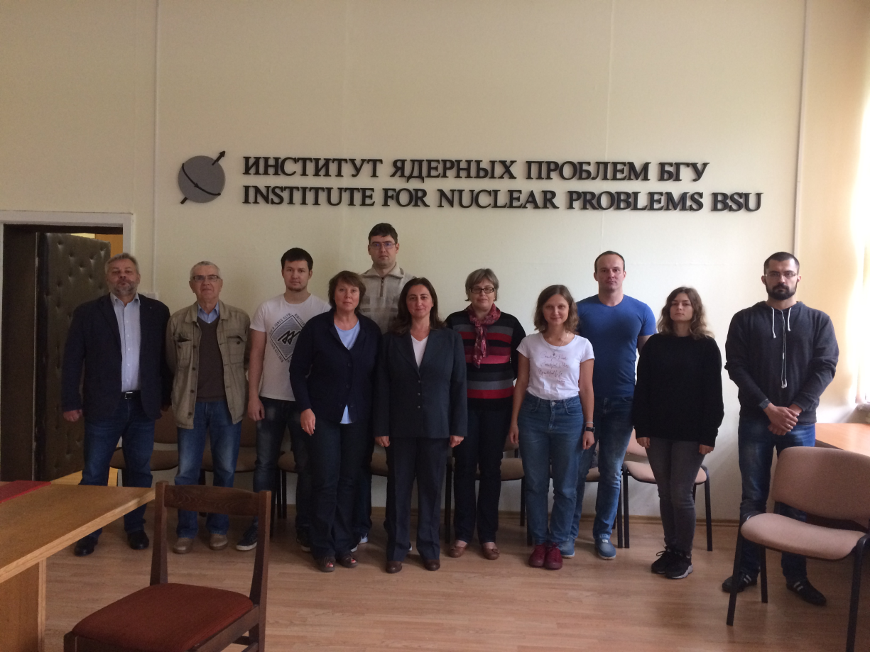
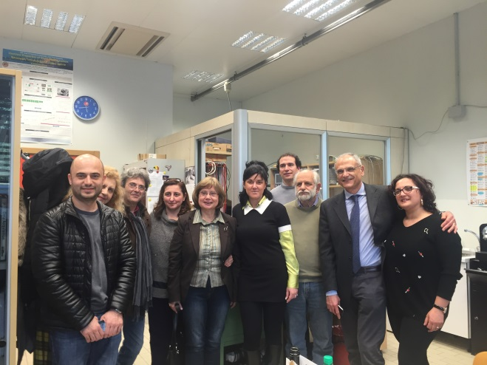
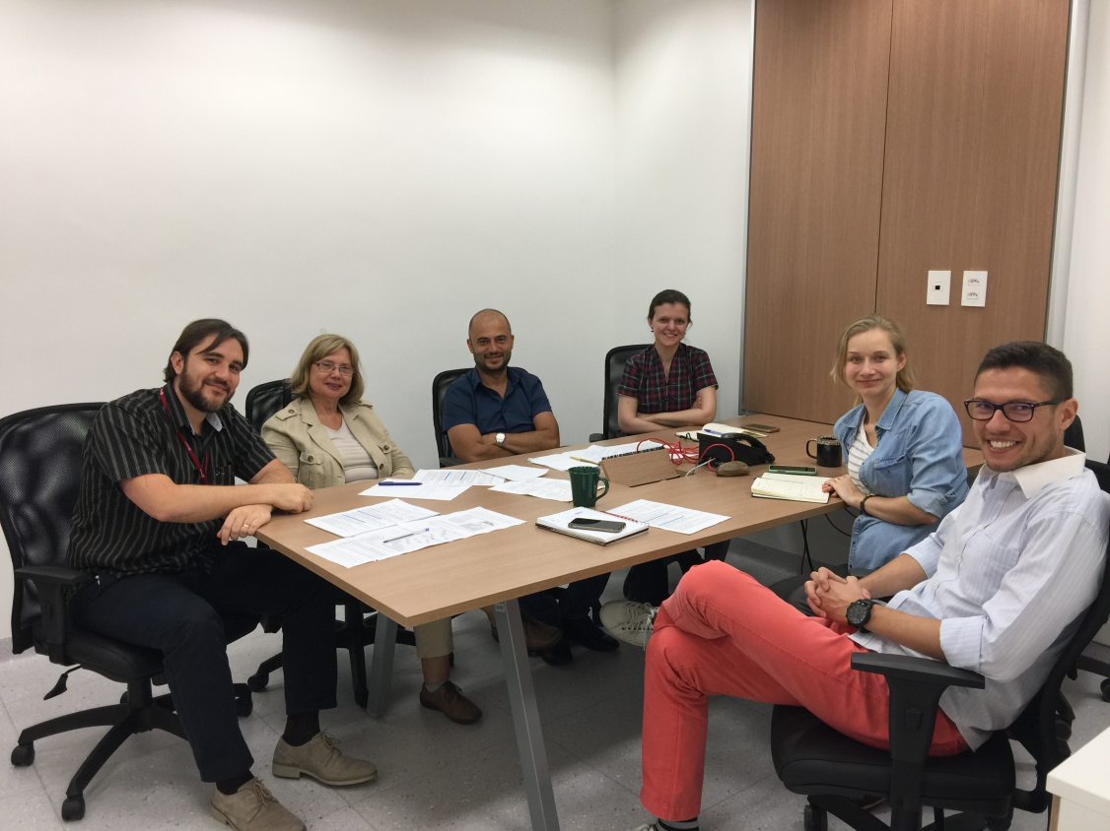
http://graphene3d.imbm.bas.bg graphene3d.project@gmail.com
H2020-MSCA-RISE-2016-734164 Graphene 3D
MULTIFUNCTIONAL GRAPHENE-BASED NANOCOMPOSITES WITH ROBUST ELECTROMAGNETIC
AND THERMAL PROPERTIES FOR
3D-PRINTING APPLICATION
Graphene 3D is an EU H2020 MSCA-RISE 48-months project, started on 01/01/2017 and coordinated by the Institute of Mechanics, Bulgarian Academy of Sciences (IMech-BAS)/Open Laboratory on Experimental Micro and Nano Mechanics (OLEM).
OBJECTIVES OF GRAPHENE 3D:
Develop and produce polymer nanocomposite material, doped by graphene and carbon nanotubes, with robust multifunctional properties for 3D printing application.
Fabricate 3D printed cellular structures for power electronics application with predefined properties (electromagnetic wave absorption, thermal conductivity, mechanical strength and lightness) on the basis of modeling, simulation and experimental validation.
Create “Joint Laboratory on Graphene-Polymer Research” for long-term knowledge impact.
GRAPHENE 3D PARTNERS AND EVENTS
PARTNERS:
Institute of Mechanics - BAS (Coordinator) – Bulgaria
Consiglio Nazionale Delle Ricerche /IPCB – Italy
Narrando srl – Italy
Universite de Namur ASBL (UNamur) – Belgium
Università degli Studi di Salerno (UniSa) – Italy
Nanotechlab Ltd. – Bulgaria
I. V. Sukhumi Inst. Physics &Technology – Georgia
Institute for Nuclear Problems, BSU – Belarus
Sichuan University / SKLPME – China
Mack Graphe - MACKENZIE – Brazil
GRAPHENE 3D WORKSHOPS:
22-26 May 2018 – Int. Workshop at UNamur, Belgium
25 May 2018 – Mid-term Review Meeting EC, in Namur
2019 – Training School at UniSa, Salerno, Italy
2020 – Final Workshop “H2020 - Graphene 3D”
Kick-Off Meeting, 24-25 January 2017, Brussels
MB/MC meeting, 17-21 July 2017, at IMech-BAS, in Sofia
GRAPHENE 3D SECONDMENTS AND SEMINARS

